Slide 1
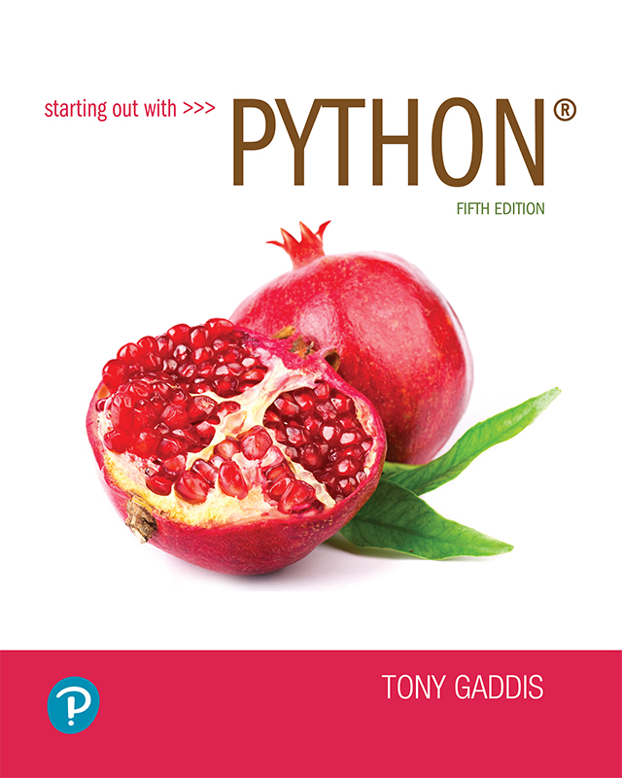
Starting out with Python
Fifth Edition
Chapter 3
Decision Structures and Boolean Logic
Copyright © 2021, 2018, 2015 Pearson Education, Inc. All Rights Reserved

Slide 2
Topics
The if Statement
The if-else Statement
Comparing Strings
Nested Decision Structures and the if-elif-else Statement
Logical Operators
Boolean Variables
Turtle Graphics: Determining the State of the Turtle

Slide 3
The if Statement (1 of 4)
Control structure: logical design that controls order in which set of statements execute
Sequence structure: set of statements that execute in the order they appear
Decision structure: specific action(s) performed only if a condition exists
  Also known as selection structure

Slide 4
The if Statement (2 of 4)
In flowchart, diamond represents true/false condition that must be tested
Actions can be conditionally executed
  Performed only when a condition is true
Single alternative decision structure: provides only one alternative path of execution
  If condition is not true, exit the structure

Slide 5
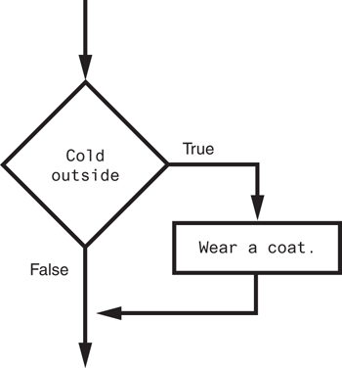
The if Statement (3 of 4)
Figure 3-1 A simple decision structure

Slide 6
The if Statement (4 of 4)
Python syntax:
  if condition:
    Statement
    Statement
First line known as the if clause
  Includes the keyword if followed by condition
    The condition can be true or false
    When the if statement executes, the condition is tested, and if it is true the block statements are executed. otherwise, block statements are skipped

Slide 7
Boolean Expressions and Relational Operators (1 of 5)
Boolean expression: expression tested by if statement to determine if it is true or false
  Example: a > b
    true if a is greater than b; false otherwise
Relational operator: determines whether a specific relationship exists between two values
  Example: greater than (>)

Slide 8
Boolean Expressions and Relational Operators (2 of 5)
>= and <= operators test more than one relationship
  It is enough for one of the relationships to exist for the expression to be true
== operator determines whether the two operands are equal to one another
  Do not confuse with assignment operator (=)
!= operator determines whether the two operands are not equal

Slide 9
Boolean Expressions and Relational Operators (3 of 5)
Table 3-2 Boolean expressions using relational operators
Expression | Meaning
x > y | Is x greater than y?
x < y | Is x less than y?
x >= y | Is x greater than or equal to y?
x <= y | Is x less than or equal to y?
x == y | Is x equal to y?
x != y | Is x not equal to y?

Slide 10
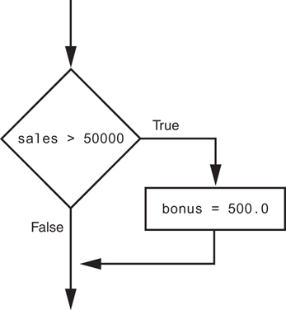
Boolean Expressions and Relational Operators (4 of 5)
Using a Boolean expression with the > relational operator
Figure 3-3 Example decision structure

Slide 11
Boolean Expressions and Relational Operators (5 of 5)
Any relational operator can be used in a decision block
  Example: if balance == 0
  Example: if payment != balance
It is possible to have a block inside another block
  Example: if statement inside a function
  Statements in inner block must be indented with respect to the outer block

Slide 12
The if-else Statement (1 of 3)
Dual alternative decision structure: two possible paths of execution
  One is taken if the condition is true, and the other if the condition is false
  Syntax: if condition:
    statements
    else:
    other statements
  if clause and else clause must be aligned
  Statements must be consistently indented

Slide 13
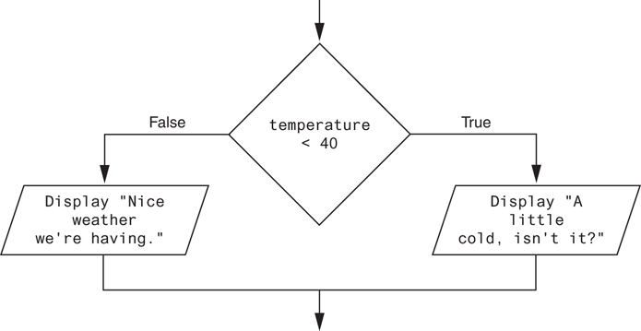
The if-else Statement (2 of 3)
Figure 3-5 A dual alternative decision structure

Slide 14
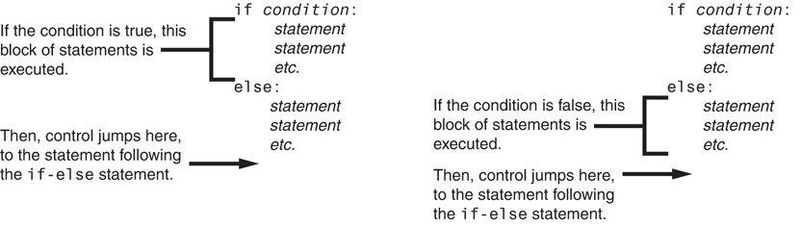
The if-else Statement (3 of 3)
Figure 3-6 Conditional execution in an if-else statement

Slide 15
Comparing Strings (1 of 2)
Strings can be compared using the == and != operators
String comparisons are case sensitive
Strings can be compared using >, <, >=, and <=
  Compared character by character based on the ASCII values for each character
  If shorter word is substring of longer word, longer word is greater than shorter word

Slide 16
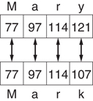
Comparing Strings (2 of 2)
Figure 3-9 Comparing each character in a string

Slide 17
Nested Decision Structures and the if-elif-else Statement (1 of 3)
A decision structure can be nested inside another decision structure
  Commonly needed in programs
  Example:
    Determine if someone qualifies for a loan, they must meet two conditions:
      Must earn at least $30,000/year
      Must have been employed for at least two years
    Check first condition, and if it is true, check second condition

Slide 18
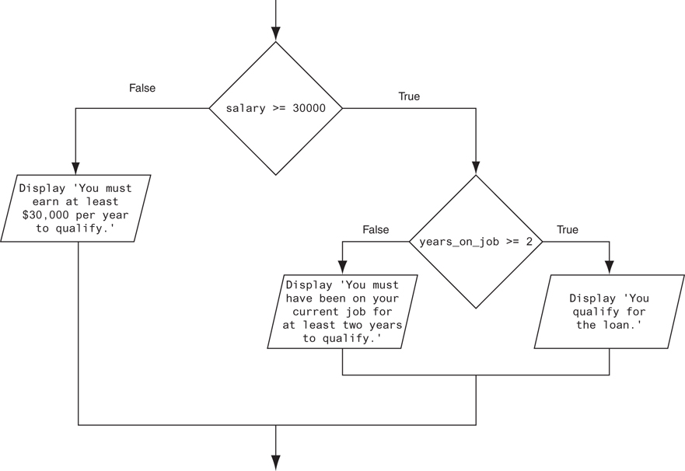
Nested Decision Structures and the if-elif-else Statement (2 of 3)
Figure 3-12 A nested decision structure

Slide 19
Nested Decision Structures and the if-elif-else Statement (3 of 3)
Important to use proper indentation in a nested decision structure
  Important for Python interpreter
  Makes code more readable for programmer
  Rules for writing nested if statements:
    else clause should align with matching if clause
    Statements in each block must be consistently indented

Slide 20
The if-elif-else Statement (1 of 3)
if-elif-else statement: special version of a decision structure
  Makes logic of nested decision structures simpler to write
    Can include multiple elif statements
  Syntax:
if condition_1:
statement(s)
elif condition_2:
statement(s)
elif condition_3:
statement(s)
else
statement(s)
Insert as many elif clauses
as necessary.

Slide 21
The if-elif-else Statement (2 of 3)
Alignment used with if-elif-else statement:
  if, elif, and else clauses are all aligned
  Conditionally executed blocks are consistently indented
if-elif-else statement is never required, but logic easier to follow
  Can be accomplished by nested if-else
    Code can become complex, and indentation can cause problematic long lines

Slide 22
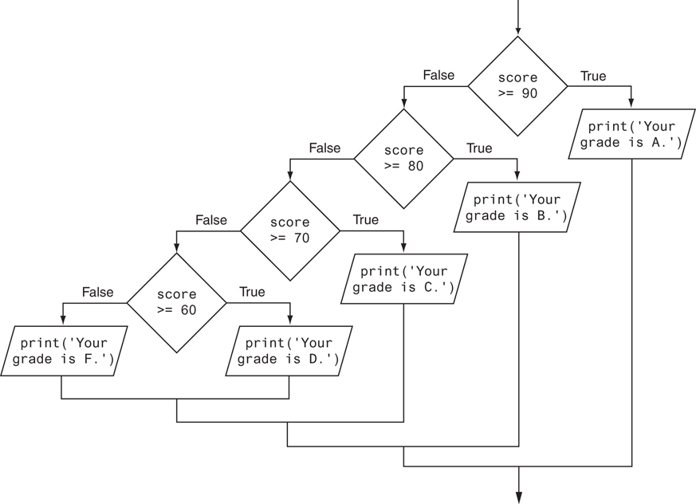
The if-elif-else Statement (3 of 3)
Figure 3-15 Nested decision structure to determine a grade

Slide 23
Logical Operators
Logical operators: operators that can be used to create complex Boolean expressions
  and operator and or operator: binary operators, connect two Boolean expressions into a compound Boolean expression
  not operator: unary operator, reverses the truth of its Boolean operand

Slide 24
The and Operator
Takes two Boolean expressions as operands
  Creates compound Boolean expression that is true only when both sub expressions are true
  Can be used to simplify nested decision structures
Truth table for the and operator
Value of the Expression | Expression
false | false and false
false | false and true
false | true and false
true | true and true

Slide 25
The or Operator
Takes two Boolean expressions as operands
  Creates compound Boolean expression that is true when either of the sub expressions is true
  Can be used to simplify nested decision structures
Truth table for the or operator
Value of the Expression | Expression
false | false and false
true | false and true
true | true and false
true | true and true

Slide 26
Short-Circuit Evaluation
Short circuit evaluation: deciding the value of a compound Boolean expression after evaluating only one sub expression
  Performed by the or and and operators
    For or operator: If left operand is true, compound expression is true. Otherwise, evaluate right operand
    For and operator: If left operand is false, compound expression is false. Otherwise, evaluate right operand

Slide 27
The not Operator
Takes one Boolean expressions as operand and reverses its logical value
  Sometimes it may be necessary to place parentheses around an expression to clarify to what you are applying the not operator
Truth table for the not operator
Value of the Expression | Expression
false | true
true | false

Slide 28
Checking Numeric Ranges with Logical Operators
To determine whether a numeric value is within a specific range of values, use and
  Example: x >= 10 and x <= 20
To determine whether a numeric value is outside of a specific range of values, use or
  Example: x < 10 or x > 20

Slide 29
Boolean Variables
Boolean variable: references one of two values, True or False
  Represented by bool data type
Commonly used as flags
  Flag: variable that signals when some condition exists in a program
    Flag set to False → condition does not exist
    Flag set to True → condition exists

Slide 30
Turtle Graphics: Determining the State of the Turtle (1 of 9)
The turtle.xcor() and turtle.ycor() functions return the turtle's X and Y coordinates
Examples of calling these functions in an if statement:
if turtle.ycor() < 0:
turtle.goto(0, 0)
if turtle.xcor() > 100 and turtle.xcor() < 200:
turtle.goto(0, 0)

Slide 31
Turtle Graphics: Determining the State of the Turtle (2 of 9)
The turtle.heading() function returns the turtle's heading. (By default, the heading is returned in degrees.)
Example of calling the function in an if statement:
if turtle.heading() >= 90 and turtle.heading() <= 270:
turtle.setheading(180)

Slide 32
Turtle Graphics: Determining the State of the Turtle (3 of 9)
The turtle.isdown() function returns True if the pen is down, or False otherwise.
Example of calling the function in an if statement:
if turtle.isdown():
turtle.penup()
if not(turtle.isdown()):
turtle.pendown()

Slide 33
Turtle Graphics: Determining the State of the Turtle (4 of 9)
The turtle.isvisible() function returns True if the turtle is visible, or False otherwise.
Example of calling the function in an if statement:
if turtle.isvisible():
turtle.hideturtle()

Slide 34
Turtle Graphics: Determining the State of the Turtle (5 of 9)
When you call turtle.pencolor() without passing an argument, the function returns the pen's current color as a string. Example of calling the function in an if statement:
When you call turtle.fillcolor() without passing an argument, the function returns the current fill color as a string. Example of calling the function in an if statement:
if turtle.pencolor() == 'red':
turtle.pencolor('blue')
if turtle.fillcolor() == 'blue':
turtle.fillcolor('white')

Slide 35
Turtle Graphics: Determining the State of the Turtle (6 of 9)
When you call turtle.bgcolor() without passing an argument, the function returns the current background color as a string. Example of calling the function in an if statement:
if turtle.bgcolor() == 'white':
turtle.bgcolor('gray')

Slide 36
Turtle Graphics: Determining the State of the Turtle (7 of 9)
When you call turtle.pensize() without passing an argument, the function returns the pen's current size as a string. Example of calling the function in an if statement:
if turtle.pensize() < 3:
turtle.pensize(3)

Slide 37
Turtle Graphics: Determining the State of the Turtle (8 of 9)
When you call turtle.speed()without passing an argument, the function returns the current animation speed. Example of calling the function in an if statement:
if turtle.speed() > 0:
turtle.speed(0)

Slide 38
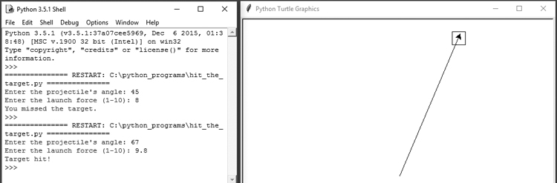
Turtle Graphics: Determining the State of the Turtle (9 of 9)
See In the Spotlight: The Hit the Target Game in your textbook for numerous examples of determining the state of the turtle.

Slide 39
Summary
This chapter covered:
  Decision structures, including:
    Single alternative decision structures
    Dual alternative decision structures
    Nested decision structures
  Relational operators and logical operators as used in creating Boolean expressions
  String comparison as used in creating Boolean expressions
  Boolean variables
  Determining the state of the turtle in Turtle Graphics

